Slide 1

Sprocket Central Pty Ltd
Data analytics approach
[KPMG Data Analytics Intern] - [Akaanksha Mishra]

Slide 2
Agenda
Introduction
Data Exploration
Feature Engineering
Feature Selection
Model Development
Interpretation

Slide 3
Introduction
Identifying high-value customers from amongst 1000 new Customers
Sprocket Central Pvt. Ltd. specializes in high-quality bikes and accessible cycling accessories
to riders.
To maximize its business, Sprocket needs a
detailed analysis of their existing customer
dataset, and then extract the insights from
that to identify customer trends and behavior to
drive marketing for a new list of 1000 customers.
To identify and recommend high-value customers from the provided list of 1000 customers, we will first analyze the labelled data (the data of existing customers provided by Sprockets). We’ll follow the below methodology–
Understanding the data distributions
Feature engineering
Data transformations
Modelling
Results interpretation
Reporting.

Slide 4
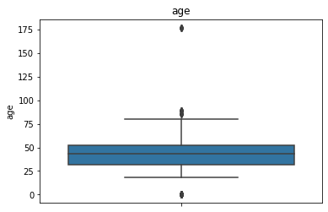
Data Exploration
First step in exploration of dataset would involve identifying inconsistencies and removing them for better analysis.
Cleaning inconsistent and irrelevant values –
Gender data, blank records, inconsistent ages and details of deceased customers in Customer Demographics
Inconsistent customer id’s, state identifier details in Customer Addresses
Blank values, date formatting, and filtering out cancelled orders in Transactions dataset
Adding a new column indicating Customer Age by using their provided DOB
Filtering results for age below 100
Understanding the distribution of continuous variables, checking the skewness and plotting the boxplot to obtain the mean, median and inter quartile range on which the attributes are distributed.
Boxplot also helps to detect the possible outliers.

Slide 5
Forming of correlation matrix among different numerical attributes to know the presence of duplicated columns or the interaction between different variables.
Forming the contingency tables across different attributes to get the insight about various factors among different categorical variables which shows strong interaction with other variables labels .
For example frequency table between “Job industry category” and “Brand” showed that most in “manufacturing” sector prefer “Solex” brand .
Checking the cardinality of categorical variables, counting their percentage in the whole dataset and making correction of those categorical variable which are having different labels for the same category.
Forming word cloud to know which are the most assigned job title or which street area address most customers are from.

Slide 6
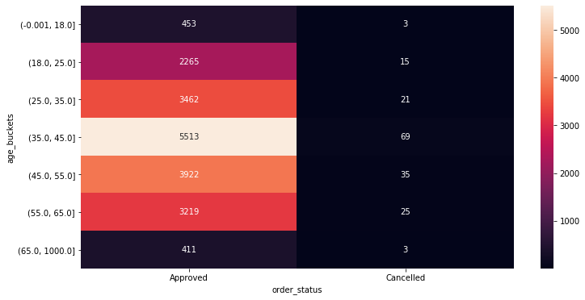
Feature Engineering
Extraction of more features from different attributes.
For example getting the age of the customers from their Date Of Birth, Discretizing the tenure, property valuation and age columns into small buckets to extracts valuable information by looking into their interaction with different variables and addressing the common business problems.
Removing some of the columns whose values are unexplainable, unnamed columns or does not contain relevant data to address common business problems
Numerical encoding of the categorical variables and adding binary indicator columns for each numerical encoded columns .

Slide 7
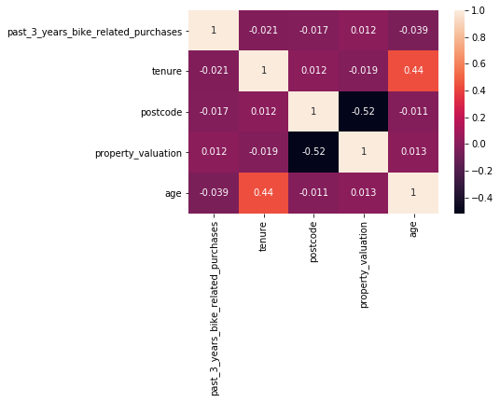
Feature Selection
We get to know the importance of each variables in Exploratory Data analysis and fix up some of the variables in feature engineering section.
In feature selection we choose those columns which are most relevant for model building, training and deploying into production.
For example, we have age bucket columns and age columns, therefore selecting the age bucket column and dropping the other.
Similarly for tenure and property valuation columns.

Slide 8
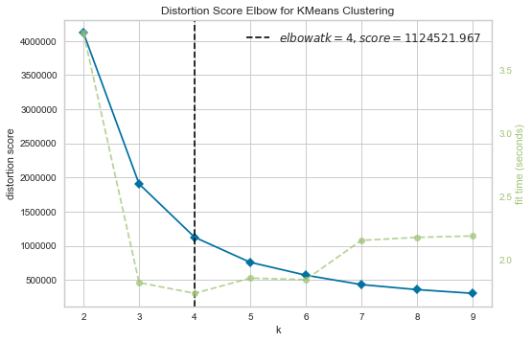
Model Development
Machine learning model building and implementation
Since the problem is of customer segmentation, so we are using k mean clustering algorithm to build our machine learning model.
This algorithm clusters those values of attributes which shows similarity with each other and labels each cluster into separate groups.
We will use Elbow method to get the best number of clusters.

Slide 9
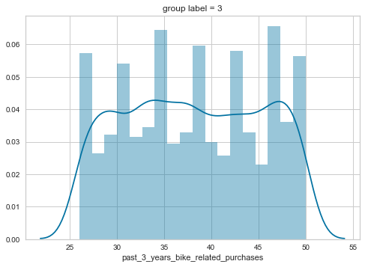
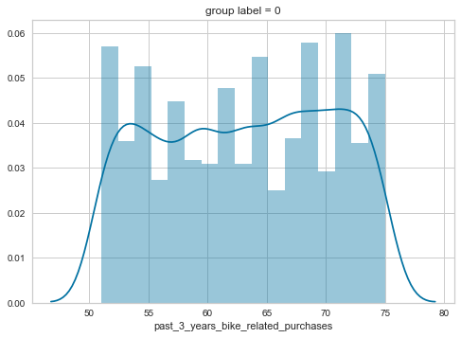
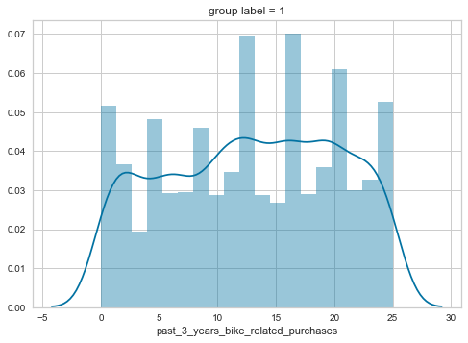
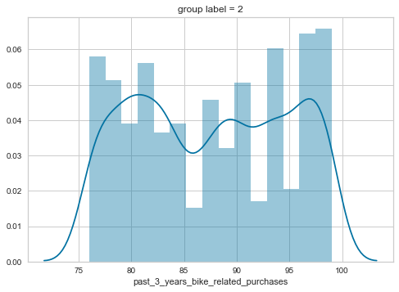
Interpretation
Post model building
After the machine learning model is build, we must interpret the results based on clusters formed. Going through each group, their attributes and how they distinguish from other groups we can answer some of the most complex problems related to business development.
For example group one’s past 5 years bike related purchase attribute ranges from 50 to 75 and group two ranges from 0 to 25 for different age buckets.

Slide 10
Mostly customers are above age 40
In both the datasets female customer percentage is more
Sales depend more on Mass Customers ,then High Net Customer and then finally Affluent Customer.
Most number of customers were seen from Manufacturing, Financial and Heath industry.

Slide 11
Appendix

Slide 12
Appendix
All the analysis have been done on the dataset provided by Sprocket Central Pty Ltd on Python language (version = 3.8, anaconda environment) in Jupyter notebook as IDE
Packages used for analysis : NumPy, Pandas, Matplotlib, Seaborn
Package used for Model building : Scikit Learn

